Slide 1
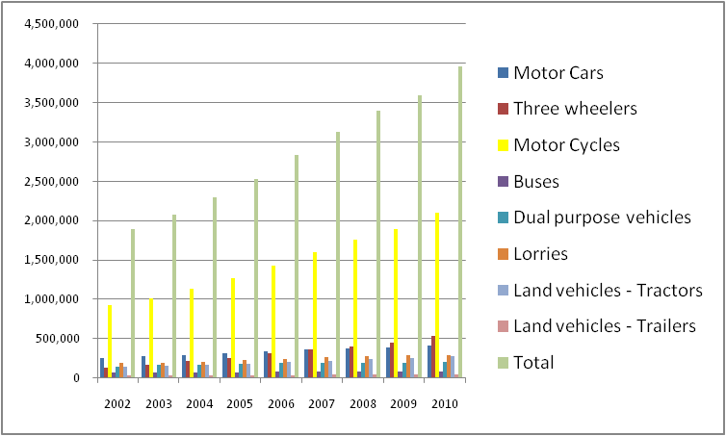
Total vehicle population in Sri Lanka
2001-2010
Total
Motor
cycles
Three
Wheelers
Source – RMV

Slide 2
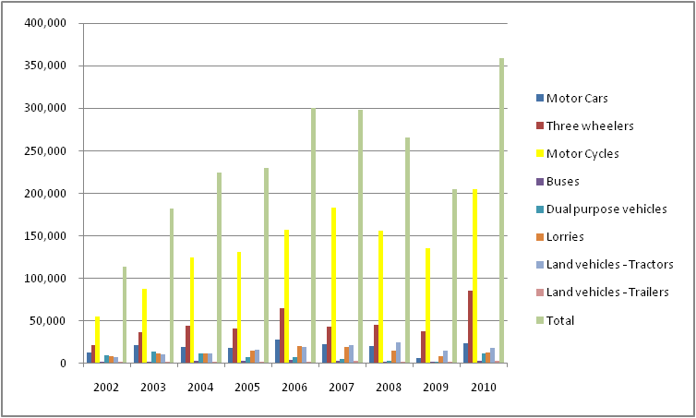
New registration of motor vehicles 2010
Motor cycles constitute the largest proportion of new registrations
Source – RMV

Slide 3
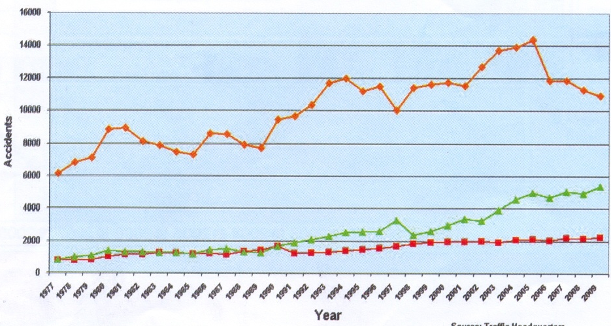
No of reported accidents in Sri Lanka
1977 - 2009
Non -Grevious
Grevious
Fatal
Source – Traffic Headquarters

Slide 4
2010 Claims statistics…..
Motor Claims received | Paid | Rejected | Claims ratio
352,695 | 346,721 | 5974 | 60%

